Slide 1


When Good Components Go Bad Formally Secure Compilation Despite Dynamic Compromise
Cătălin Hrițcu
Inria Paris
Notes:
I'm Catalin from Inria Paris and I will tell you about our work on formally secure compartmentalization.

Slide 2





Goal
Security
Proof
Enforcement
Notes:
This talk is about security, however since security can means different things to different people, here's my view on security. For me computer security is about:
1. defining clear security goals
2. building effective security enforcement mechanisms
3. and then hopefully providing some compelling evidence or proof that the enforcement does achieve the security goals.

Slide 3




Security foundations research is about making this diagram mathematically formal
1. Security Goal [What are we trying to achieve?]
negative definition: What (kind of) attacks are we trying to prevent?
positive definition: What security property are we aiming for?
2. Security Enforcement [How can we effectively achieve it?]
static: program verification, static analysis, type systems, ...
dynamic: reference monitors, hardware mechanisms, crypto, ...
trade off security vs. precision, efficiency, compatibility, ...
3. Security Proof [How can we make sure we achieved it?]

Slide 4
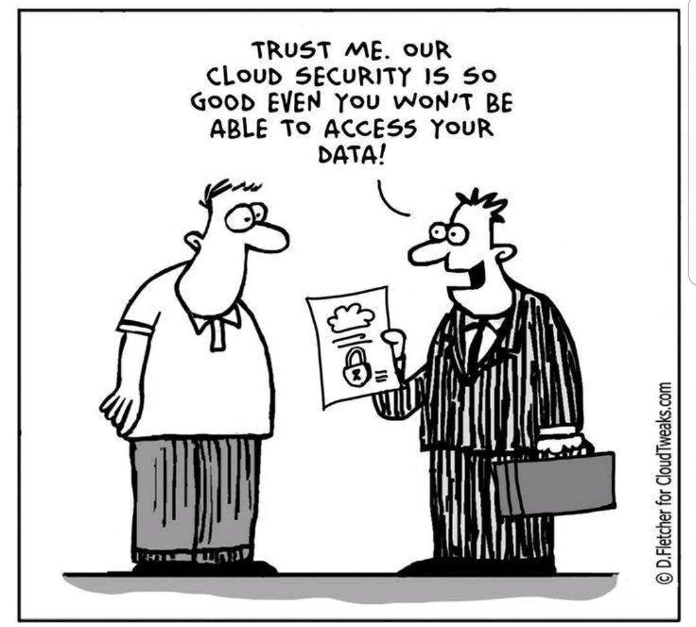

Slide 5

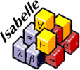



Security proof
Marketing snake oil: trussst me, it isss very sssecure
...
Security experts, metrics, standards
Informal code audit
Security testing, red teaming, bounty programs
...
Mathematical proofs with various levels of rigor
Formal, machine-checked proofs
in a proof assistant like Coq, Isabelle, HOL, F*, EasyCrypt, ...
about abstract models or concrete implementations
under various assumptions and trusted computing base
Easier and
more scalable
Better
assurance

Slide 6


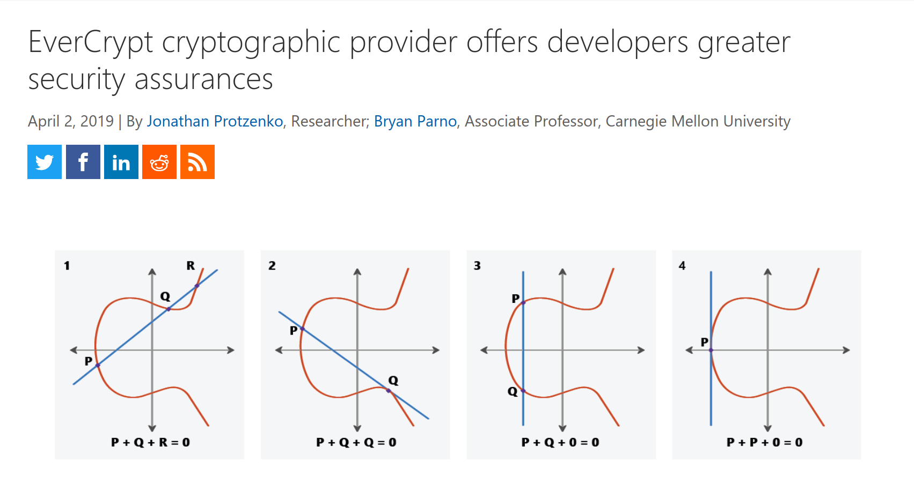

Slide 7
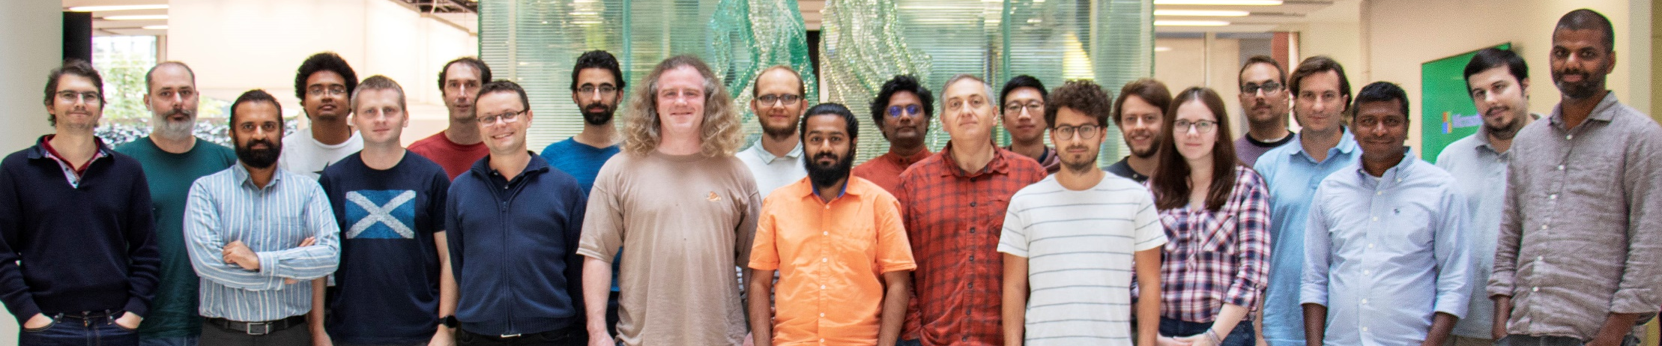
EverCrypt: Verified Crypto Provider
Verified C (HACL*): ChachaPoly, SHA2+3, Blake2, Curve25519, ...
Verified X64 ASM (Vale): AES-GCM, Poly1305, Curve25519, ...
Very good efficiency, competitive to libcrypto or libsodium
Readable C and ASM code
Deployed in production
Mozilla Firefox (NSS)
Microsoft WinQUIC
Wireguard VPN
Zinc crypto API for Linux kernel
MirageOS unikernel
Tezos and Concordium blockchains
...
Project Everest, extending this to:
verified TLS implementation
verified HTTPS stack

Slide 8

EverCrypt formally
1. Security Goals
Memory safety (no buffer overflows, use-after-frees, double-frees, ...)
Functional correctness (code implements a simpler math function)
Side-channel resistance (secret independent control & mem accesses)
Cryptographic security (e.g. auth, int, and conf of AEAD constructions)
2. Security Enforcement
static: program verification in F* for safety and correctness
side-channel resistance and crypto security involve paper proofs
3. Security Proof
milestone: 40.000+ lines of proved correct code, shipping
still: big trusted computing base, some interesting proofs on paper
Notes:
and paper theorems about side-channel resistance and crypto security

Slide 9
Formally Secure Compartmentalization When Good Components Go Bad (CCS 2018) Beyond Good and Evil (CSF 2016)

Slide 10














Core team at Inria Paris
Rob Blanco
Florian
Groult
Théo
Laurent
Jérémy Thibault
Carmine
Abate
Cătălin
Hrițcu
Collaborators
Boris Eng
Paris 7
(ex Inria)
Yannis
Juglaret
Quarkslab (ex Inria)
Arthur
Azevedo
de Amorim
CMU (ex Inria)
Ana Nora
Evans
U. Virginia
(ex Inria)
Guglielmo
Fachini
Nozomi
(ex Inria)
Benjamin
Pierce
UPenn
Marco
Stronati
Tezos
(ex Inria)
Andrew
Tolmach
Portland
State

Slide 11
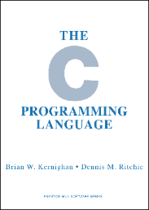
Inherently insecure languages like C
any buffer overflow can be catastrophic
~100 different undefined behaviors in the usual C compiler:
use after frees and double frees, invalid type casts, signed integer overflows, ...............................
root cause, but very challenging to fix:
efficiency, precision, scalability, backwards compatibility, deployment
Notes:
This talk is about compartmentalization, and an important use of compartmentalization these days is to mitigate the devastating low-level attacks.

Slide 12
Compartmentalization mitigation
Break up security-critical applications into mutually distrustful components with clearly specified privileges
Enforce this component abstraction all the way down
separation, static privileges, call-return discipline, types, ...
Compartmentalizing compilation chain:
compiler, linker, loader, runtime, system, hardware
Base this on efficient enforcement mechanisms:
OS processes (all web browsers) — hardware enclaves (SGX)
WebAssembly (modern web browsers) — capability machines
software fault isolation (SFI) — tagged architectures
Notes:
Practical mitigation
1
2
3. The responsibility for enforcing the component abstraction can be freely split / shared between the compiler, ..., hardware. We call all these entities a compartmentalizing compilation chain.
4

Slide 13
1. Security Goal [What are we trying to achieve?]
Hoping for strong security guarantees one can make fully water-tight
beyond just "increasing attacker effort"
Intuitively, if we use compartmentalization ...
... a vulnerability in one component does not immediately destroy the security of the whole application
... since each component is protected from all the others
... and each component receives protection as long as it has not been compromised (e.g. by a buffer overflow)
Notes:
Start: Compartmentalizing compilation seems to provide

Slide 14
Can we formalize this intuition?
What is a compartmentalizing compilation chain supposed to enforce precisely?
Formal definition expressing the end-to-end security guarantees of compartmentalization

Slide 15
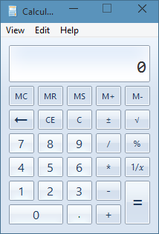
Challenge formalizing security of mitigations
We want source-level security reasoning principles
easier to reason about security in the source language if and application is compartmentalized
... even in the presence of undefined behavior
can't be expressed at all by source language semantics!
what does the following program do?
#include <string.h>
int main (int argc, char **argv) {
char c[12];
strcpy(c, argv[1]);
return 0;
}
Notes:
The main challenge with devising a formal definition for a mitifation, is that in order for such a definition to be useful, it should make it easier to reason about the security of ...

Slide 16
Compartmentalizing compilation should ...
Restrict spatial scope of undefined behavior
mutually-distrustful components
each component protected from all the others
Restrict temporal scope of undefined behavior
dynamic compromise
each component gets guarantees as long as it has not encountered undefined behavior
i.e. the mere existence of vulnerabilities doesn't necessarily make a component compromised

Slide 17
Security definition:
i₀
i₁
i₂
If
C₀
C₁
C₂
⇝ t
then
↓
↓
↓
∃ a sequence of component compromises explaining the finite trace t in the source language, for instance t=m₁·m₂·m₃ and
i₀
i₁
i₂
(1)
C₀
C₁
C₂
⇝* m₁·Undef(C₁)
↯
i₀
i₁
i₂
(2)
∃A₁.
C₀
A₁
C₂
⇝* m₁·m₂·Undef(C₂)
↯
i₀
i₁
i₂
(3)
∃A₂.
C₀
A₁
A₂
⇝ m₁·m₂·m₃
Finite trace records which component encountered
undefined behavior and allows us to rewind execution
Notes:
TODO: a lot of the explanations here happen in the air
- we say that a compartmentalizing compilation chain is secure, if whenever a program is compiled and then executed producing trace then there is a good explanation of this trace in the source language.
- the program we compile is composed in this example of 3 components: C0, C1, and C2
- the finite trace t records how the program as a whole interacts with the outside world (e.g. system calls)
- so we say that a compilation chain is secure when each trace t of the compiled program can be explained by some series of component compromises ("dynamic compromise scenario",)
TODO: Unsure the last takeaway is the best one for this slide - it seems a bit random

Slide 18

2. Security Enforcement [How can we effectively enforce this?] Proof-of-concept secure compilation chain

Slide 19


Compartmentalized unsafe source
Buffers, procedures, components
interacting via strictly enforced interfaces
Compartmentalized abstract machine
Simple RISC abstract machine with
build-in compartmentalization
software fault isolation
Micro-policy machine
Bare-bone
machine
Tag-based reference monitor enforcing:
- component separation
- procedure call and return discipline
(linear capabilities / linear entry points)
Inline reference monitor enforcing:
- component separation
- procedure call and return discipline
(program rewriting, shadow call stack)
Expectation: other enforcement mechanisms should work as well

Slide 20
Micro-Policies [Oakland’15, ASPLOS ’15,...]
software-defined, hardware-accelerated, tag-based monitoring
pc
tpc
tpc
mem[0]
tm0
r0
tr0
tr0
“store r0 r1”
tm1
tm1
r1
tr1
tr1
mem[2]
tm2
mem[3]
tm3
tm3
tm3
≠
tpc
tr0
tr1
=
tm3
tm3
tm1
store
monitor
allow
policy violation stopped!
(e.g. out of bounds write)
tpc’
tpc’
tm3’
tm3’
disallow
software monitor’s decision is hardware cached
Notes:
TODO: Switch to something more friendly to color blind people
SAY (start): They key enabler for this project is a software-hardware protection mechanism called micro-policies, on which I’ve been working in the past 4 years.
SAY (end): ... of course the software monitor can also disallow any instruction if it causes a violation of the enforce policy, for instance the monitor can disallow a write out of the bounds of an array if the color of the pointer doesn’t match the color of the memory location.
JPB: add enthusiasm, this is a really cool mechanism: efficient, fine-grained, expressive, adaptable, secure, formally verified, real – would need time to say it!

Slide 21
Compartmentalization micro-policy
memory
registers
invariant:
at most one
return capability
per call stack level
Jal r
@n
pc
...
r
stack level
linear return capability
C₁
...
current color
@Ret n
@Ret n
cross-component call
only allowed at EntryPoint
...
changed color
...@EntryPoint
@(n+1)
pc
r_{a}
...
increment
@(n+1)
Store r_{a} → ⋆r_{m}
cross-component
return only allowed
via return capability
pc
r_{a}
r_{m}
...
@(n+1)
pc
r_{a}
r_{m}
C₂
Load ⋆r_{m} → r_{a}
Jump r_{a}
@(n+1)
pc
r_{a}
r_{m}
loads and stores to the same
component always allowed
Notes:
TODO: Switch to something more friendly to color blind people

Slide 22
3. Security Proof [How can we make sure we achieved our goal?] Proof-of-concept formally secure compilation chain in Coq

Slide 23
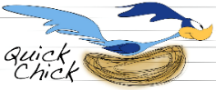
Verified
Compartmentalized unsafe source
Buffers, procedures, components
interacting via strictly enforced interfaces
generic proof technique
21K lines of Coq, mostly proofs
Compartmentalized abstract machine
Simple RISC abstract machine with
build-in compartmentalization
software fault isolation
Micro-policy machine
Bare-bone
machine
Tag-based reference monitor enforcing:
- component separation
- procedure call and return discipline
(linear capabilities / linear entry points)
Inline reference monitor enforcing:
- component separation
- procedure call and return discipline
(program rewriting, shadow call stack)
Systematically tested (with QuickChick)
https://secure-compilation.github.io

Slide 24
We reduce our proof goal to a variant of: Robust Safety Preservation
∀source components.
∀(bad/attack) finite trace t.
∃
source context
source context
source components
⇝t
.
⇒
compiler
back- translation
target context
∃
compiled components
⇝t
target context
.
Notes:
When compilation and back-translation are compositional, previous definition reduces to (a variant of) Robust Safety Preservation
Compiled components are protected enough by the secure compilation chain so that target context has no extra power compared to a source context.
TODO: could bring more intuition from previous slides

Slide 25
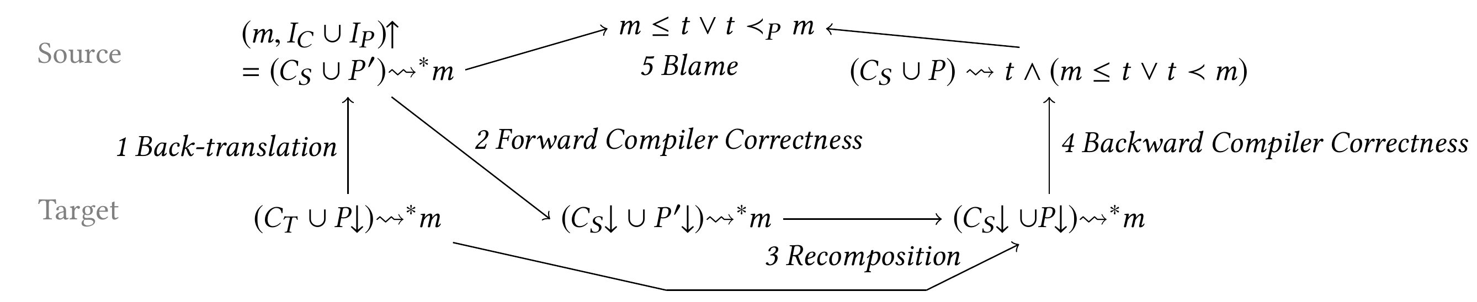
Simple and scalable proof technique (for our variant of Robust Safety Preservation)
1. back-translating finite trace prefix to whole source program
2+4. compiler correctness proof (à la CompCert) used as a black-box
3+5. also simulation proofs, but at a single level

Slide 26

When Good Components Go Bad
1. Goal: formally secure compartmentalization
first definition supporting mutually distrustful components and dynamic compromise
restricting undefined behavior spatially and temporally
2. Enforcement: proof-of-concept secure compilation chain
software fault isolation or tag-based reference monitor
3. Proof: combining formal proof and property-based testing
Generic proof technique that extends and scales well

Slide 27
Making this more practical ... next steps:
Scale formally secure compilation chain to C language
allow pointer passing (capabilities)
eventually support enough of C to measure and lower overhead
check whether hardware support (tagged architecture) is faster
Extend all this to dynamic component creation
rewind to when compromised component was created
... and dynamic privileges
capabilities, dynamic interfaces, history-based access control, ...
From robust safety to hypersafety (confidentiality) [CSF'19]
Secure compilation of EverCrypt, miTLS, ...
Notes:
TODO: add different trace models, mapping properties

Slide 28
My dream: secure compilation at scale
language
EverCrypt
C language
+ components
+ memory safety
memory safe C component
legacy C component
ASM language
(RISC-V + micro-policies)
ASM component
Notes:
SAY (beginning): The dream is to achieve secure compilation at scale at scale for realistic programming language

Slide 29
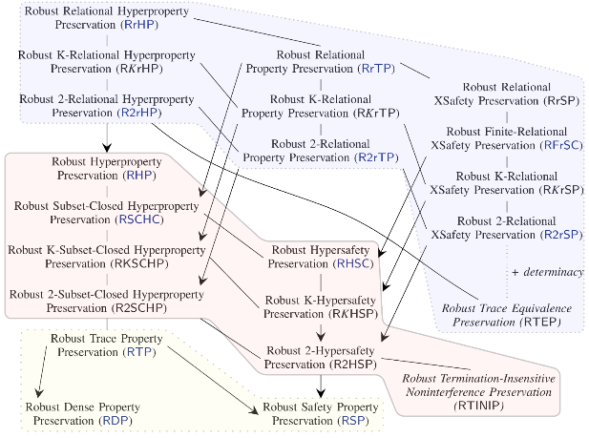


Going beyond Robust Preservation of Safety Journey Beyond Full Abstraction (CSF 2019)
Rob Blanco
Deepak
Garg
Jérémy Thibault
Carmine
Abate
Cătălin
Hrițcu
Marco
Patrignani
Inria Paris
MPI-SWS
Inria Paris
Inria Paris
Inria Paris
Stanford
& CISPA

Slide 30

Going beyond Robust Preservation of Safety [CSF'19]
No one-size-fits-all security criterion
relational
hyperproperties
(trace equivalence)
More secure
+ code confidentiality
current
proof
technique
realistically
enforceable?
hyperproperties
(noninterference)
+ data confidentiality
More efficient
to enforce
Easier to prove
trace properties
(safety & liveness)
only integrity

Slide 31
When Good Components Go Bad
1. Goal: formally secure compartmentalization
first definition supporting mutually distrustful components and dynamic compromise
restricting undefined behavior spatially and temporally
2. Enforcement: proof-of-concept secure compilation chain
software fault isolation or tag-based reference monitor
3. Proof: combining formal proof and property-based testing
Generic proof technique that extends and scales well

